Slide 1
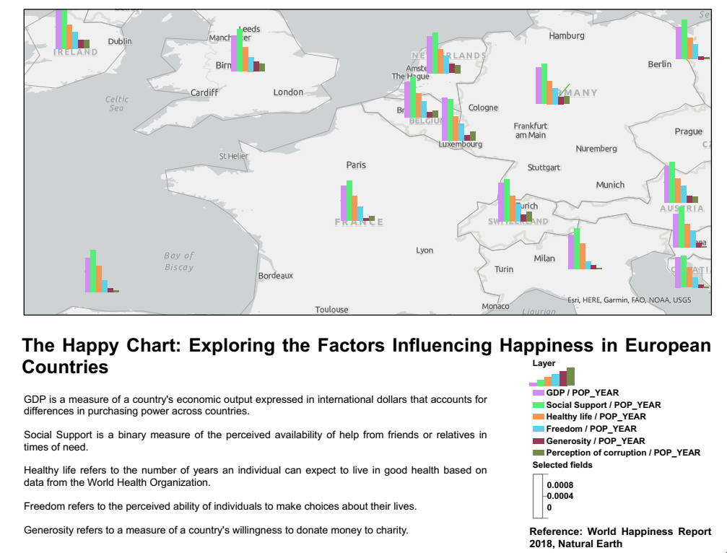

Slide 2
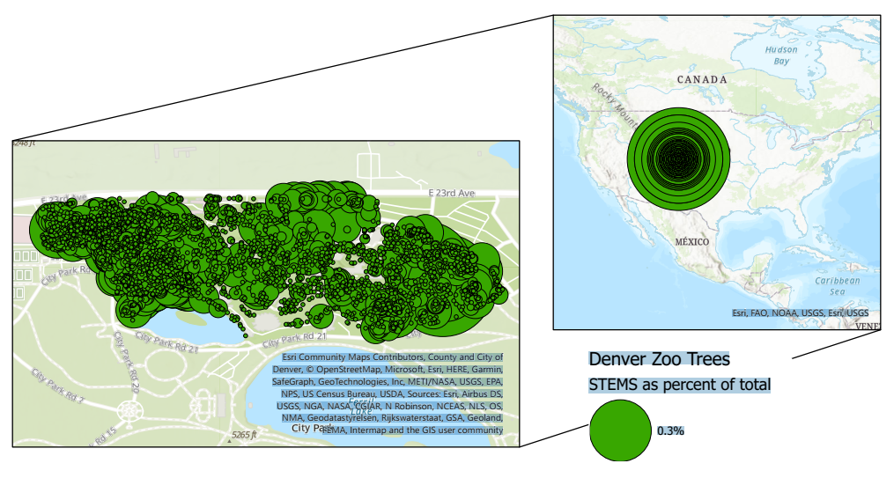
Resource: Natural Earth

Slide 3
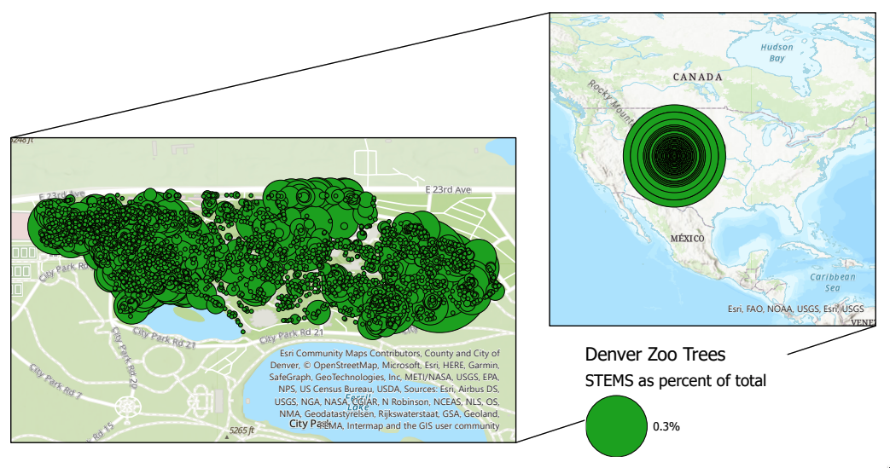
Reference: Natural Earth

Slide 4
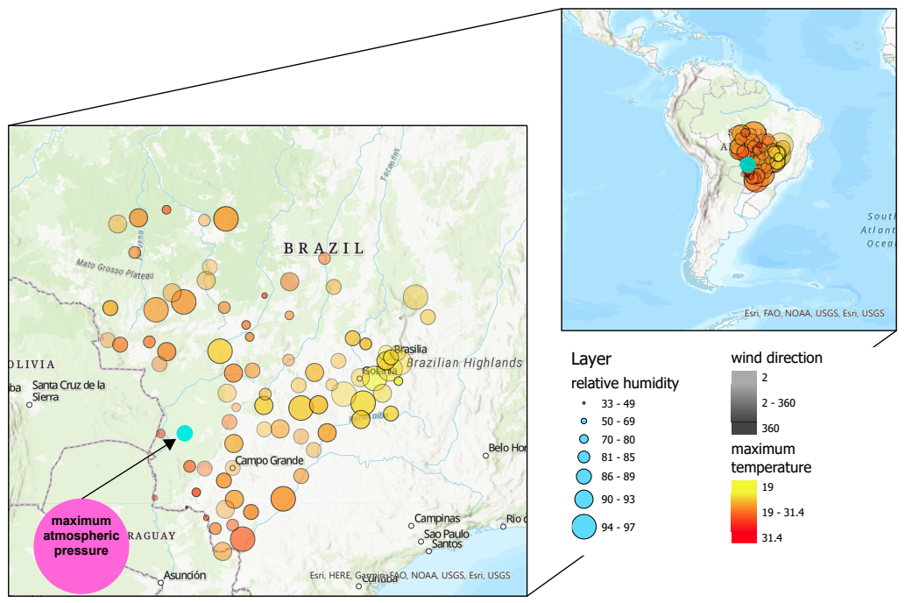
Reference: Natural Earth

Slide 5
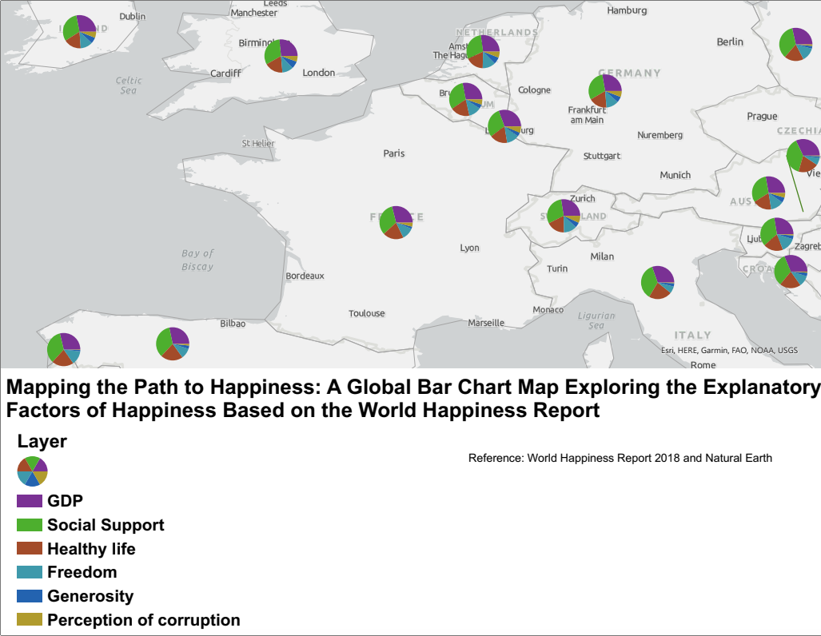
A Global Pie Map Exploring the Explanatory

Slide 6
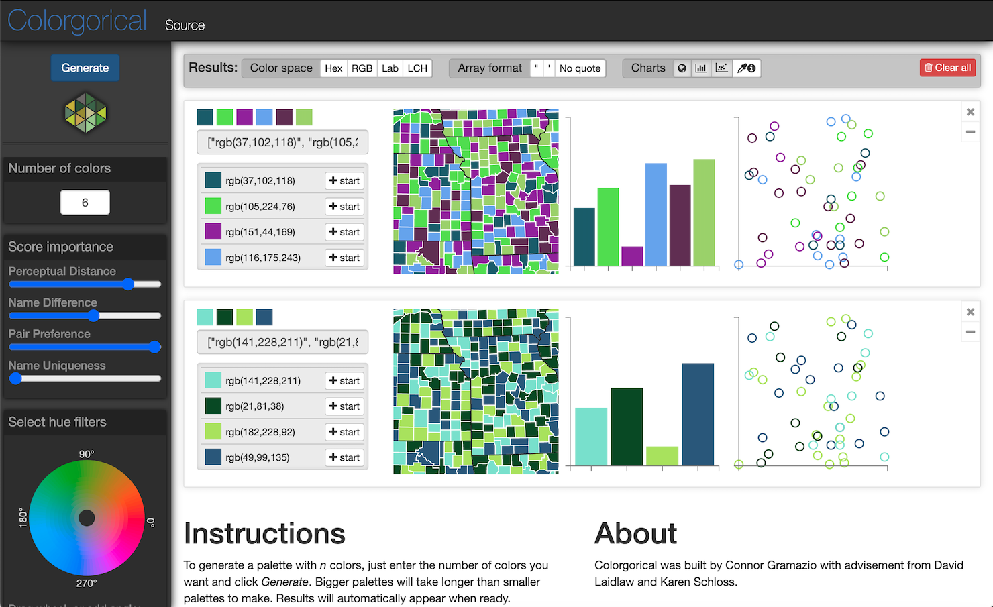
(Image source) Lm. (2021, November 13). Colorgorical. Tools for Academic Research | KausalFlow. https://tools.kausalflow.com/tools/colorgorical/

Slide 7
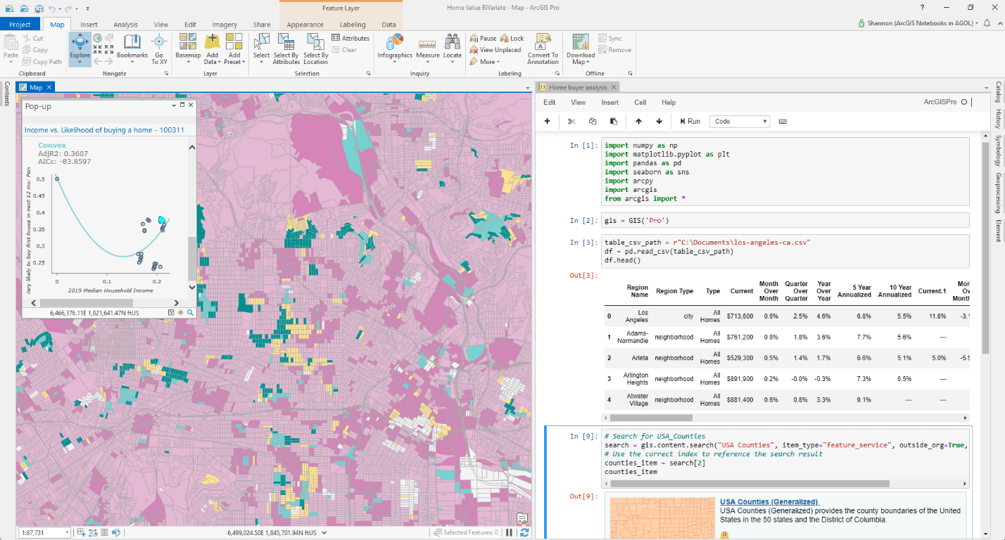
Gimmler, L., & Gimmler, L. (2020). Introducing ArcGIS Notebooks in ArcGIS Pro. ArcGIS Blog. https://www.esri.com/arcgis-blog/products/arcgis-pro/analytics/introducing-arcgis-notebooks-in-arcgis-pro/

